Slide 1

Food Truck on Campus
Presented by: JavaNPython
(Jingqi Zhang, Yufei Ye, Ryan Chun Kin Siek, Chengmin Jiang, Shuqi He)
Notes:
Good evening everyone, I am David, the spokesperson for our team Java and Python. Today, we’re going to present our design of Online Food Truck Ordering System.

Slide 2
Agenda
Introduction/Problem Space
User Needs Analysis
Research methods
Field Study
Questionnaire
Interview
Users Needs
Students’ needs
Owners’ needs
Pilot Test
Low-fi
High-fi
Final Product
Unique Features
Improvements
Notes:
Here is our agenda for today. We will start off with the introduction, going into user needs analysis, pilot test, and finish off with our final product.

Slide 3
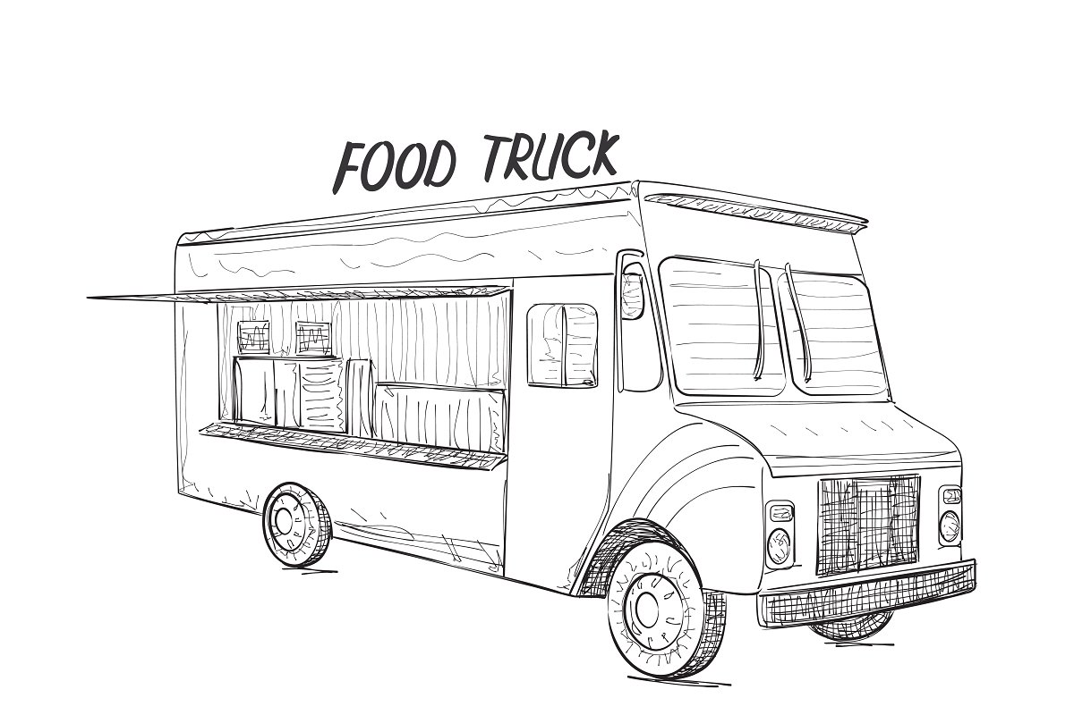
Introduction / Problem Space
Scenario: U of T students having very tight schedule
Within 10 mins break: commute to class & buy food
Solution: Food trucks on campus
Fast
Convenient
Variety of food
Reasonable price
Notes:
Before we get into our finished product, I want to explain to you the rationale behind our project. Let’s get into a realistic scenario. For us U of T students, we always have very tight schedules, and sometimes within the 10 minutes break we have to sprint to the other side of the queens park like a marathon runner. On top of the limited gap, we may also need to grab a quick lunch or else we have to be starving for the next couple of hours. With that in mind, going to the food trucks on campus would be a logical choice, as they are fast, convenient, and offer a variety of food with reasonable price.

Slide 4
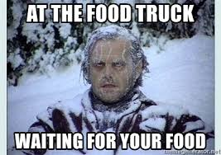
Introduction / Problem Space
Peak hours: extremely crowded
Long waiting time for ordering and picking up
Crowdedness scares away potential customers
Objectives
Bring back efficiency for the food ordering process
Obtain users’ satisfaction
food truck owners
customers
Notes:
However, during lunch and dinner hours, the food trucks are extremely crowded. There is usually a long line for ordering and a huge cluster of people waiting for their food. The huge crowd also scares away potential customers, which is indeed a missed opportunity for the food truck owners. We question ourselves: is there a problem in the food ordering process? How can we make it more efficient like it supposed to be? This becomes the basis for our investigation, to bring back the efficiency and to reach satisfaction of our users, both the food truck owners and the customers.

Slide 5
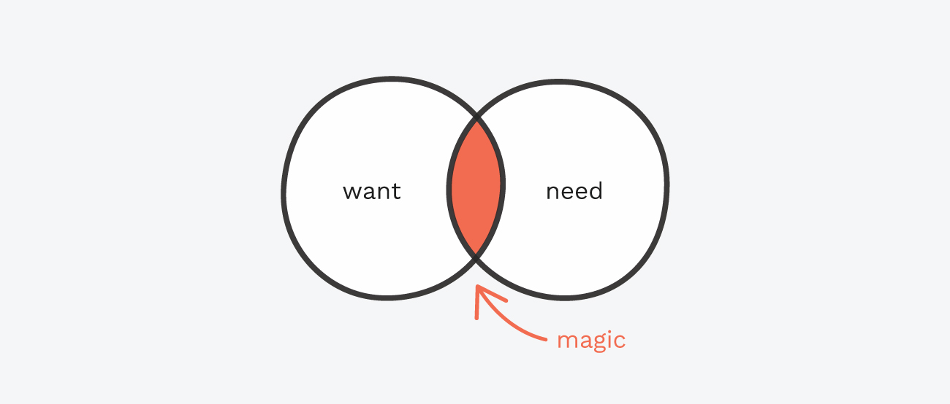
Part 2
User Needs Analysis
Notes:
Now we move on to the User Needs Analysis.

Slide 6
Research Method: Field Study
Sample size: 80 students
4 different trucks: control for effect of cuisine differences (Western vs. Eastern) on the average waiting time
Data: Average waiting time from waiting in line to receiving the food
 | Peak Hours (11-1pm, 5-7pm) | Non-Peak Hours (1-5pm) | Total
Average Waiting Time (mins) | 9:16 | 5:37 | 7:27
Notes:
To test if our concern is acknowledged by the potential users, we split into groups conducting three different researches. We start with the Field Study by observing students at the food trucks. We observed 80 students at 4 different trucks, and the average total waiting time is around 7 and half minutes from waiting in line until receiving the food. To better analyze the information, we regroup the data into Peak Hours VS. Non-Peak Hours. The average waiting time during peak hours is 9:16 and non-peak hours is 5:37. Be aware, we only have 10 minutes during the break and students are spending more than half of the break time to only receive the food.

Slide 7
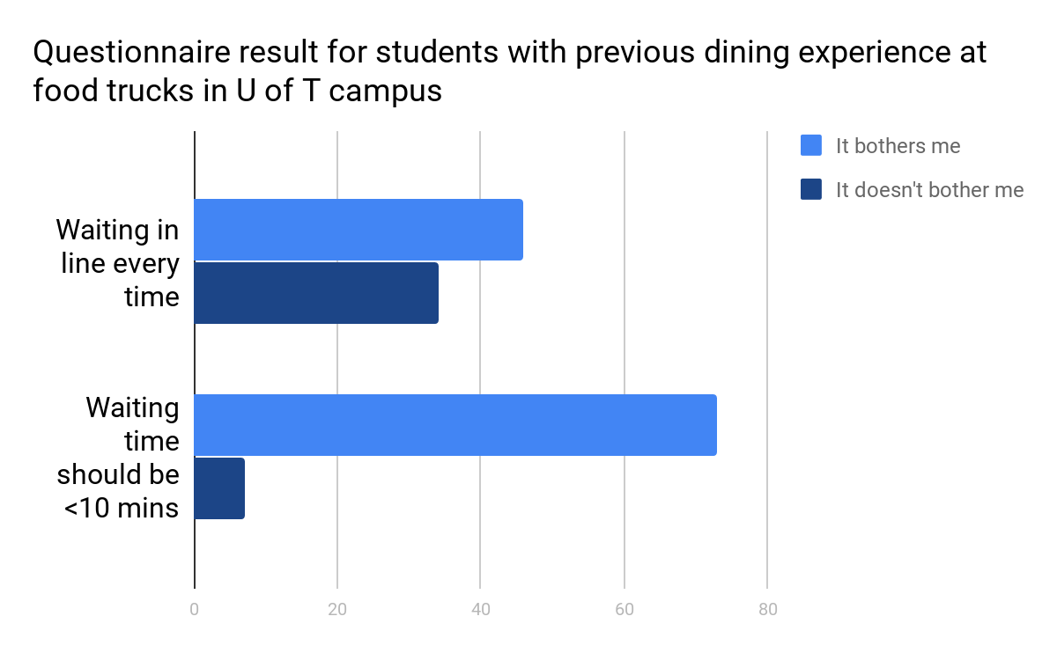

Research Method: Questionnaire
Notes:
We also send out a questionnaire to 80 students who have dining experience at the food trucks. 46 complained about waiting in line every single time and 73 believe the waiting time should be less than 10 minutes. Clearly, majority of participants agree with the ongoing problematic waiting time situation.

Slide 8
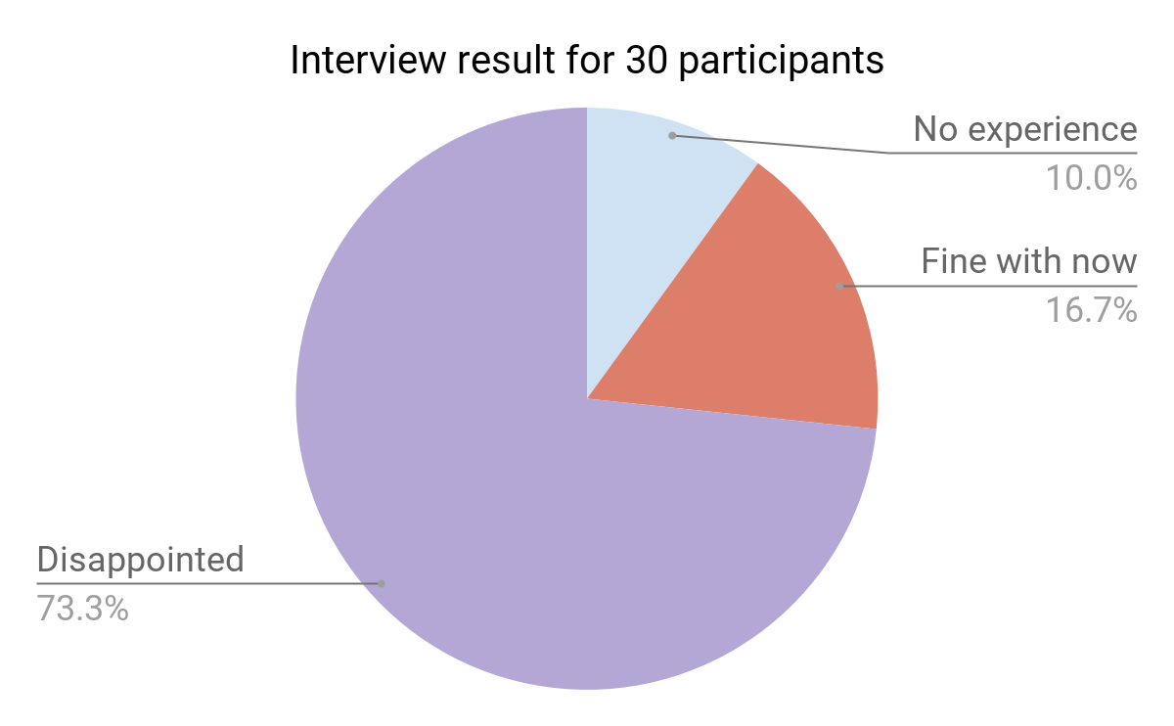
Research Method: Interview
Notes:
We interview 30 randomly-chose participants from the campus. Only 3 of them told us they never stop by the food truck. 5 said they are fine with current situation, and 22 shared with us the causes of their disappointing experience.

Slide 9

So the problems are...
Food Truck Owners
Students
Overly long waiting time (late for class)
Limited payment method (cash only)
Language barrier
people cut in line
Received wrong dishes
Too busy and might give students the wrong dish
Depressing to see students are leaving the line due to long wait time
Notes:
These issues include overly long waiting time, limited payment methods, language barriers, people cutting in line, and receiving wrong order. By only collecting buyers’ information does not seem to be enough. We need to know if owners are trapped in the dilemma, too. We interview a few food truck owners and summarized the information they provide. They admitted that it is inevitable to give wrong orders a few times a day and it bothers them watching students losing patience and leaving the line.

Slide 10

Part 3
Pilot Test
Notes:
After we finishing collecting and summarizing the data, it is time for us to build our desired prototype that can solve the problems.

Slide 11
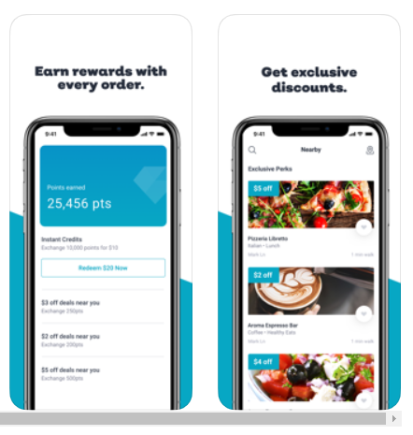
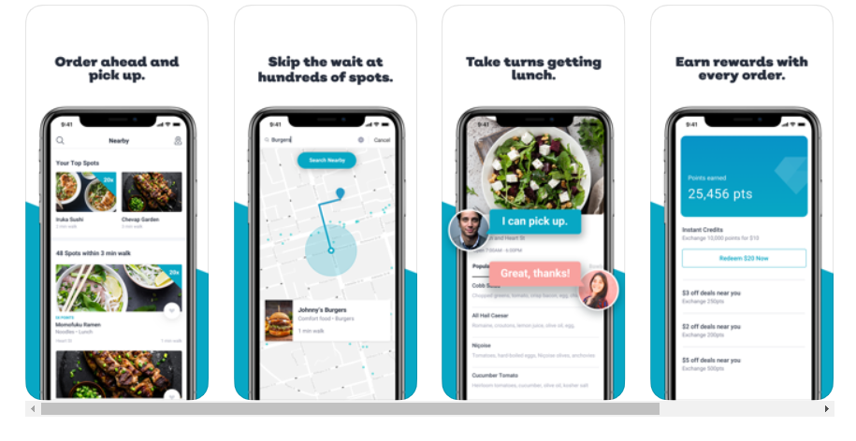
Origin of Idea
Inspired by RITUAL
platform that allows users to place order online and pick up in store
Our system: for food trucks specifically
can cater to our users’ needs
Notes:
Inspired by RITUAL, a platform that allows users to place order online and pick up in store, we have decided to create an improved online ordering system for food trucks specifically, featuring elements that suit our users the best. We will review these elements later when we talk about our final design.

Slide 12
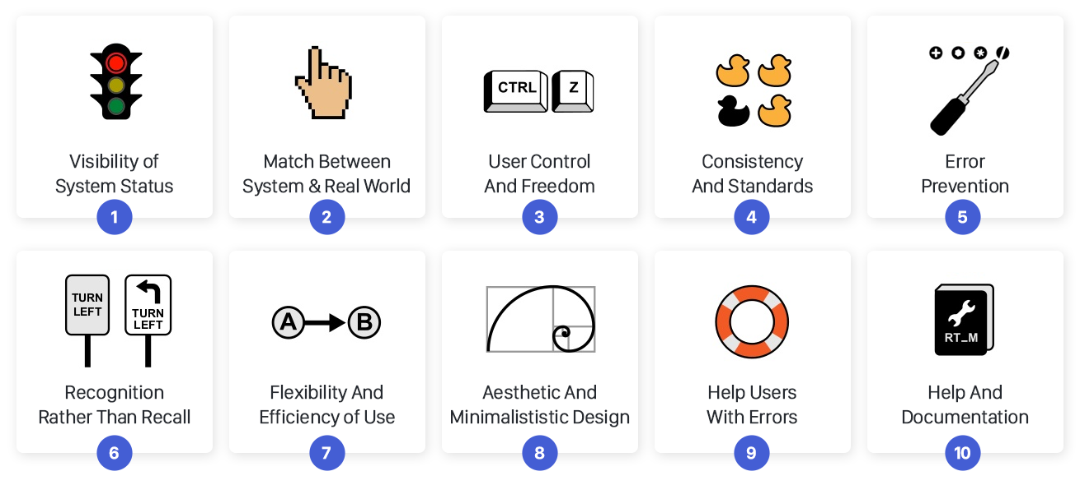
Low-Fi Prototypes
Need to work on Heuristic Evaluations below:
3 - User Control and freedom
4 - Consistency and Standards
7- Flexibility and efficiency of use
8 - Aesthetic and minimalist design
Notes:
We started with drawing five Low-fi prototypes by hands. Although these prototypes do not seem to be decorated, they helped us to review some of the most important Heuristic Evaluation problems reflected by our participants during the Low-fi experiment. These problems include: User Control and Freedom, Consistency and Standards, Flexibility and Efficiency of Use, and Aesthetic and Minimalist Design. Analyzing the reflections, we upgraded and combined our system into one High-fi prototype on Axure.

Slide 13
High-Fi Prototypes
Used Axure for the Hi-Fi prototypes
Tasks include
Log In & Sign Up
Place or accept an order
Create or edit owner’s menu
Change payment method
Problems: functionality and visual design
Dead-end buttons
Distracting information
Notes:
In our High-fi tests, participants were asked again to complete two of four tasks during the experiment, featuring both the systems of buyers and food truck owners. These tasks include “Log In & Sign Up”, “Place or accept an order”, “Create or edit owner’s menu,” and “Change payment method.” Our expert participants pointed out some questions regarding of the functionality and visual designs. Distracting information and dead-end buttons forbid us to run the system smoothly.

Slide 14

Part 4
Final Product
Notes:
Eventually, we solved these issues, and now please welcome the final project of our Food Truck Online Ordering System. Here is a short clip of the buyer’s system and demonstration of its functionality.

Slide 15

Buyer’s System

Slide 16
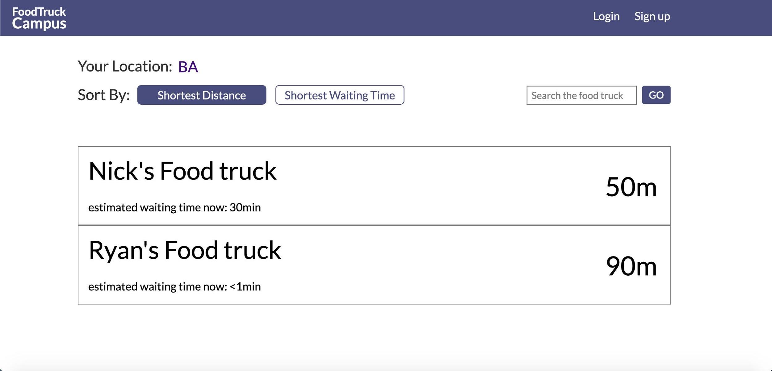
Our Features
Notes:
Let us dissect the process of placing an order on our system and discover the featured elements that Ritual cannot offer. Firstly, users can search food trucks by “shortest distance” or

Slide 17
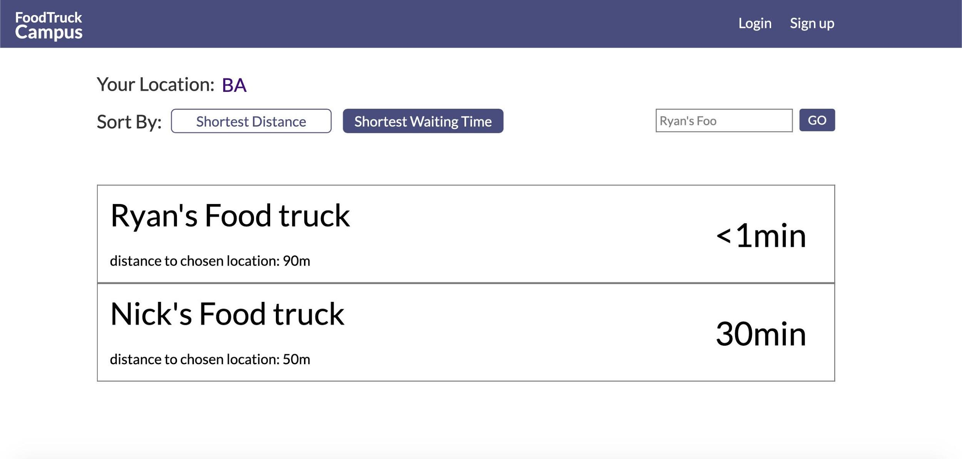
Our Features
Notes:
“shortest waiting time” or even just type in the name of the food truck. The trucks will be listed in order, and users can decide the one that fits them the best at the moment.

Slide 18
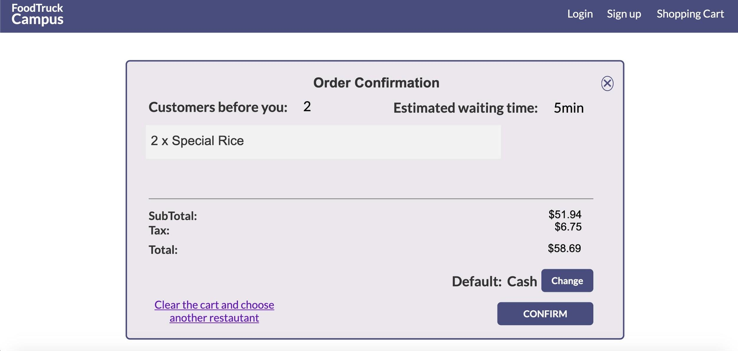
Our Features
Notes:
The second feature is while confirming the order, the system shows how many customers are before you and what the estimated waiting time will be. Besides, users can change the payment method or clear the cart if they are not satisfied with the waiting time.

Slide 19
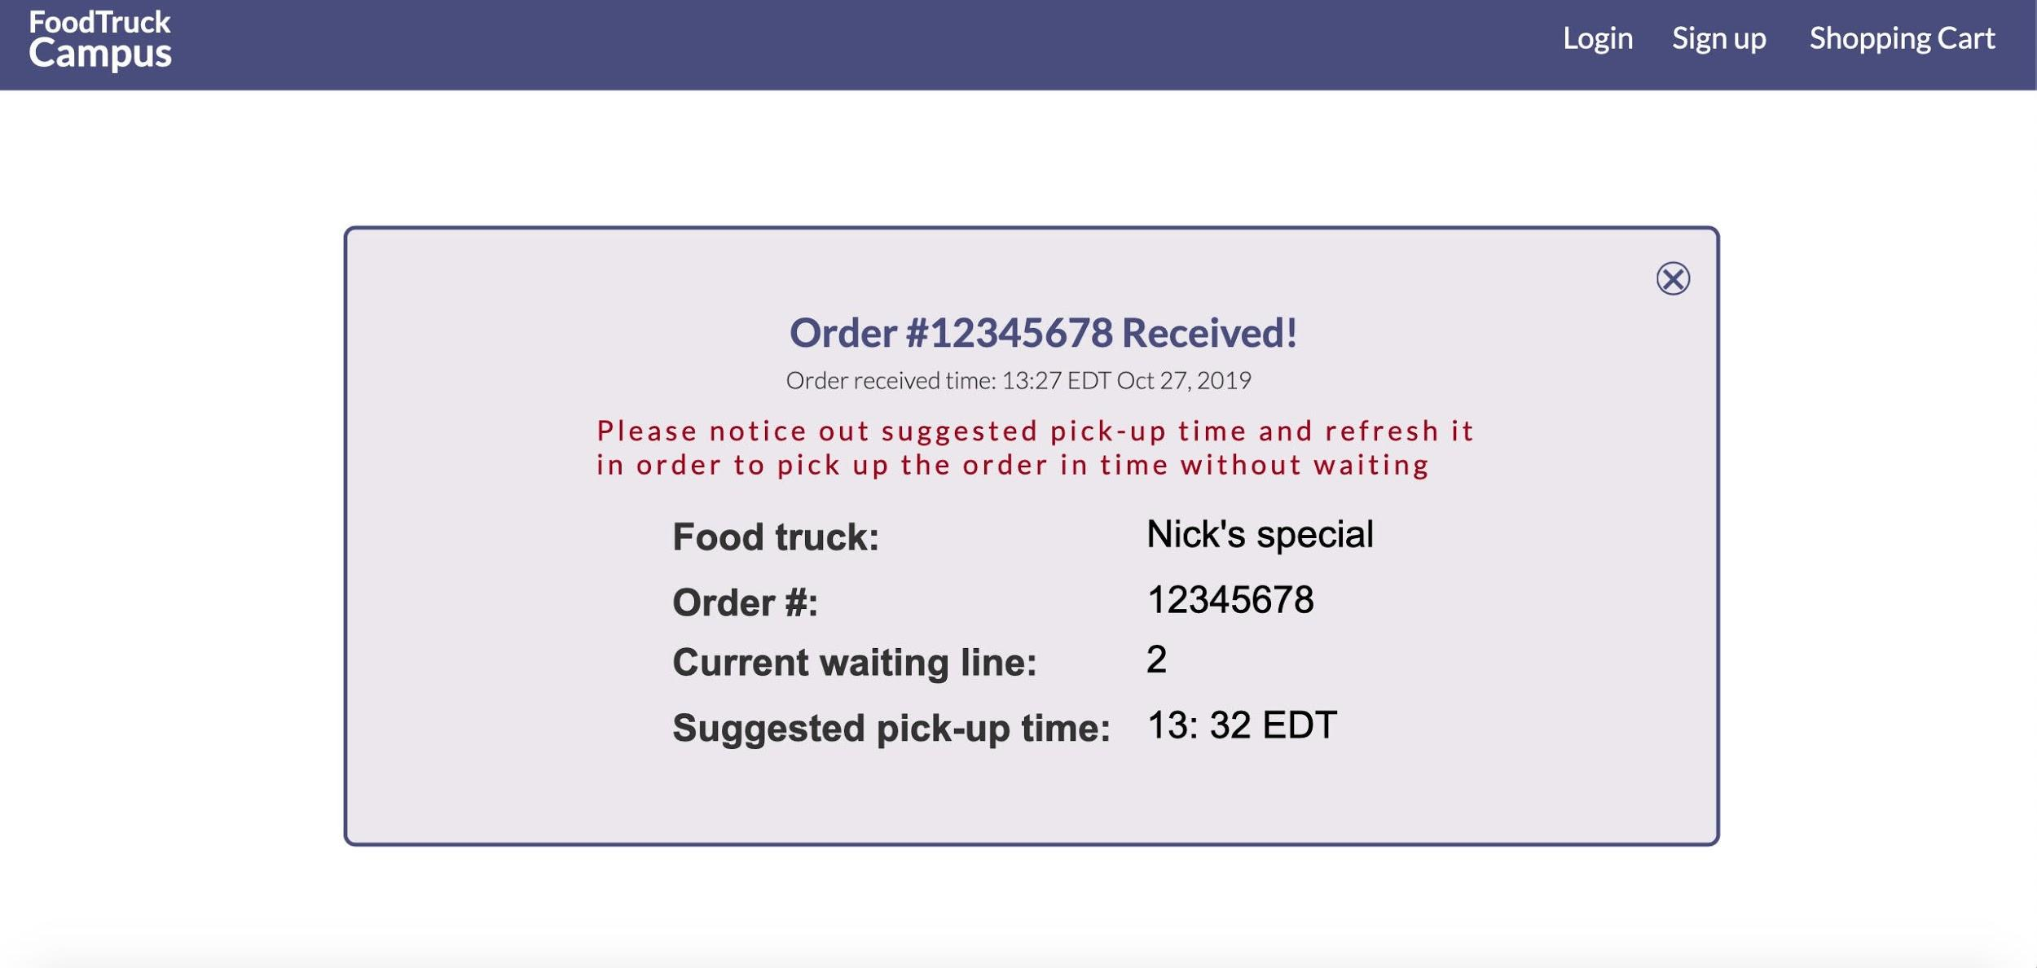
Our Features
Notes:
Eventually, after confirmed the order, the final notification will provide the suggested pick-up time for the buyers. Making sure they will not arrive too early or late. Now, let us move on to the owner’s system.

Slide 20

Owner’s System
Notes:
Here is the short clip of how owner’s system functions from logging in.

Slide 21
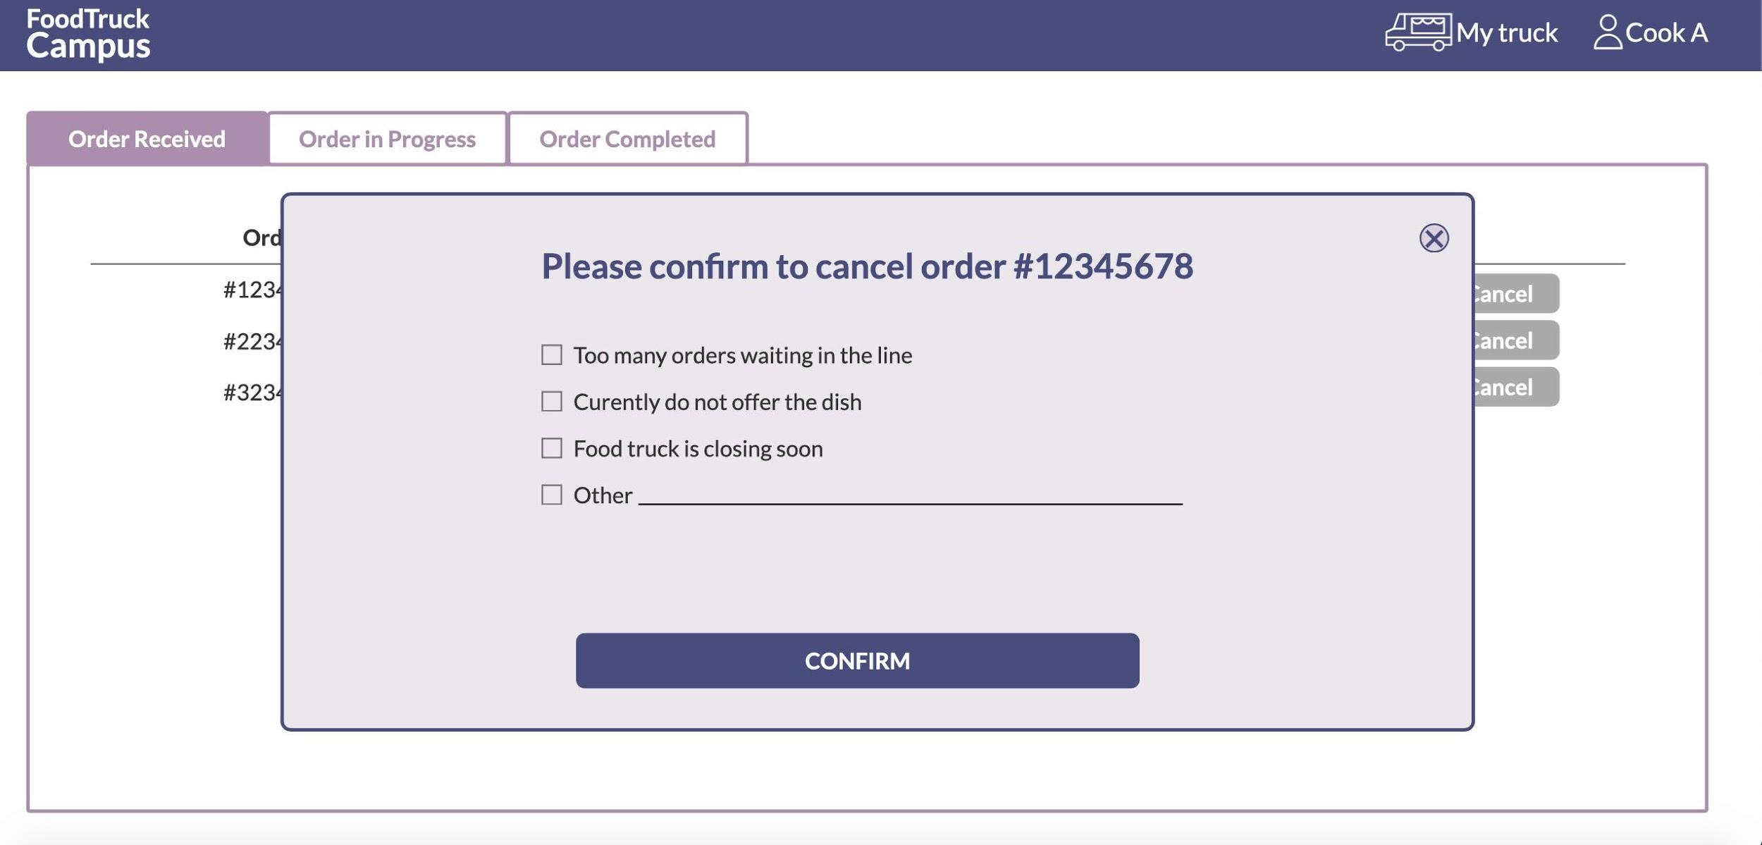
Our Features
Notes:
The first feature we have for the owners is that they can cancel any requested order with various reasons. Owners do not have to contact customer service or call the buyers to cancel.

Slide 22
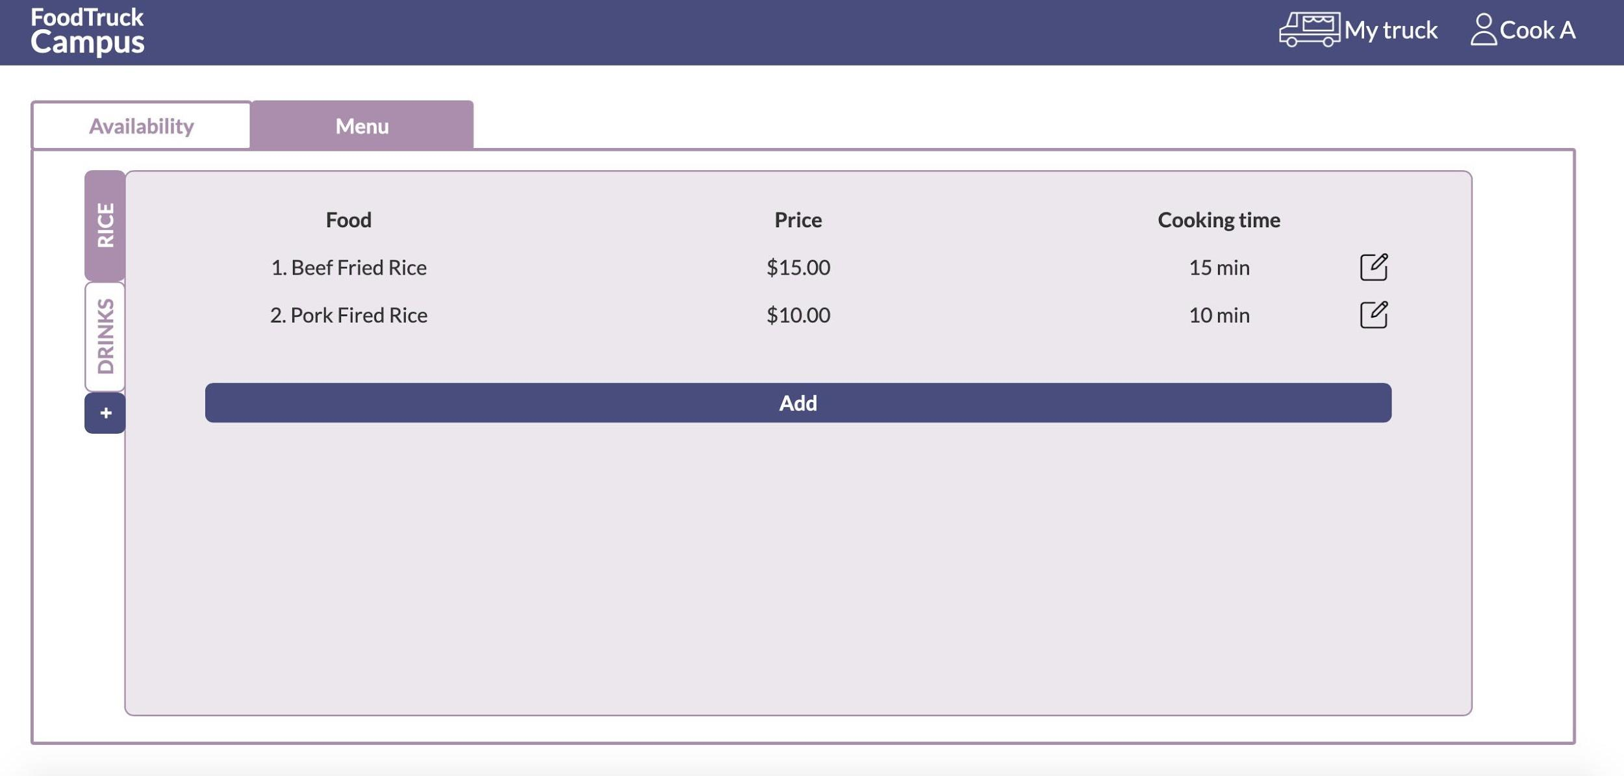
Our Features
Notes:
The very last feature is that while creating or editing the menu, the owners have to type in the estimated cooking time for each dish in order to calculate the total waiting time for the buyers, which is mentioned as one of the features of buyers’ system.

Slide 23
Improvements
Food Truck Owners
Students
(Buyers)
Can place order ahead of time
Can pay with card
Avoid miscommunication
Relevant and user-friendly interface
Earn more
Can prepare food ahead of time
Can spread workload evenly
Less likely to give out wrong item
Notes:
To summarize, we believe our system can successfully make the food ordering system more efficient. Students can place orders ahead of the time to avoid waiting, use other payment methods such as debit card, avoid miscommunication, and experience more user-friendly features. For owners, they can earn more by preparing food ahead of time and spread the workload evenly. With a clear text in front of them, it is also less likely to give out the wrong dish.

Slide 24
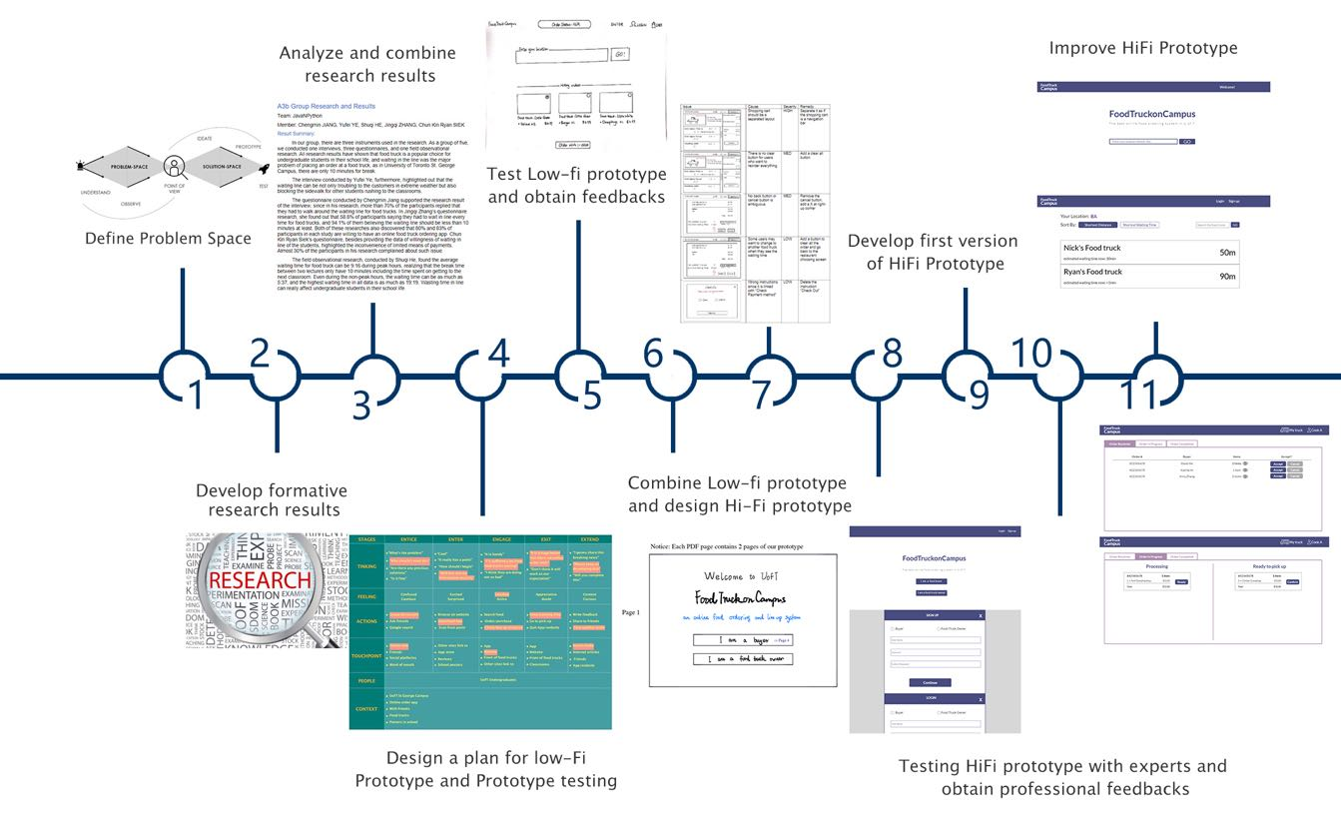
Thank you for following us in this journey!
Notes:
Thank you very much for listening and I hope you all enjoy this journey with us. We welcome any questions you may have.

